Slide 1

Democracy and federalism, let’s federate the federalists !
Milan, september 21st 2018
Why do we need an European federation ?
Presentation by Michel Caillouët, FAEF
Former EU Ambassador

Slide 2
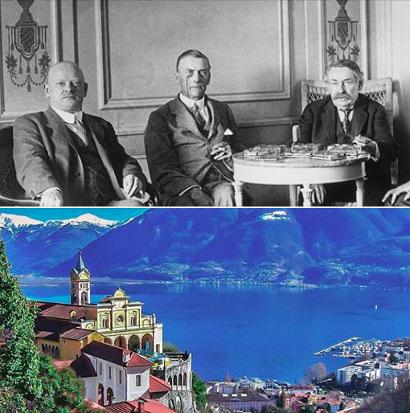
LOCARNO, 1st DECEMBER 1925
ARISTIDE BRIAND, WITH GUSTAV STRESEMANN, CHAMBERLIN...
"WE MET TOGETHER, WE SPOKE EUROPEAN....."

Slide 3
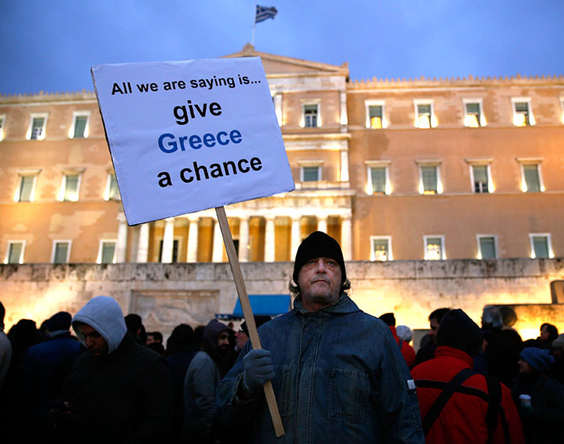

If Europe had been a federation….
I have a dream….
I have a dream
Debt crisis less severe…
Fundamental rights more respected…

Slide 4
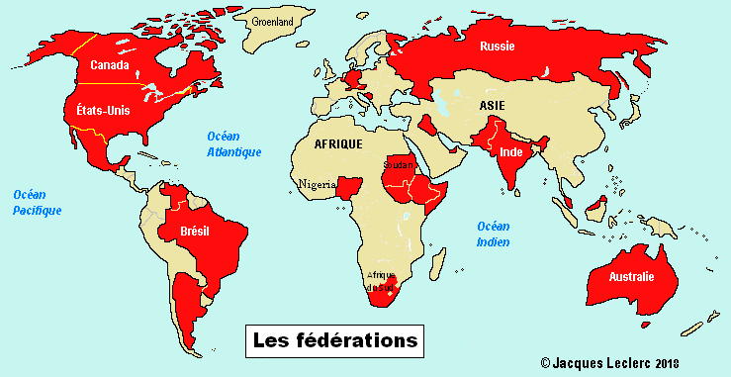
27 countries in the world are federations
2/3 of world population

Slide 5
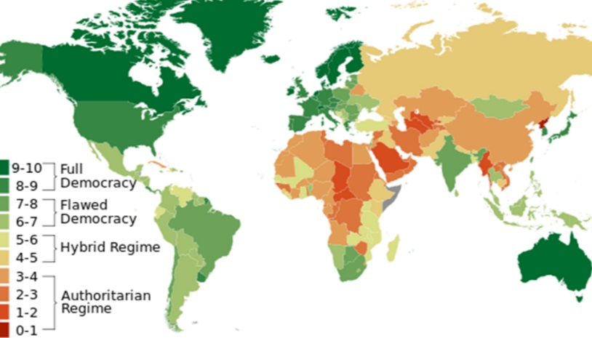
But they are not all « democracies » : Russia, Comores, Nigeria, Somalia….

Slide 6
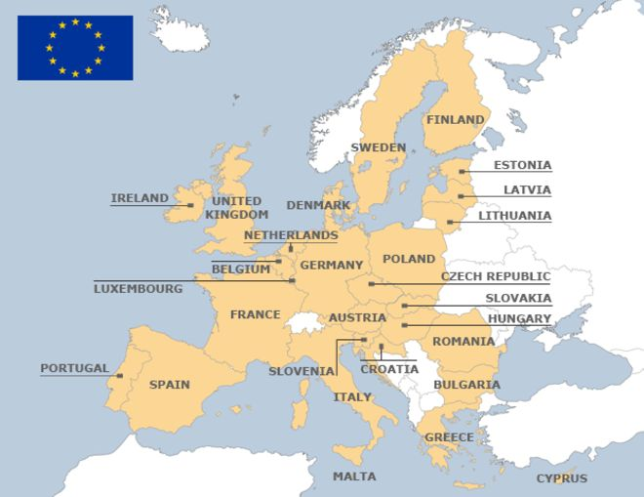
Eu, a confederation ? A sui generis construction ?
Intergovernemental…..

Slide 7
European Union : 70 years of useful but too slow evolution.
Alfred Stepan :
« Each of a long standing democracy operating in a multilingual or multinational social context is a federal state »
EU is not yet….Why ?

Slide 8
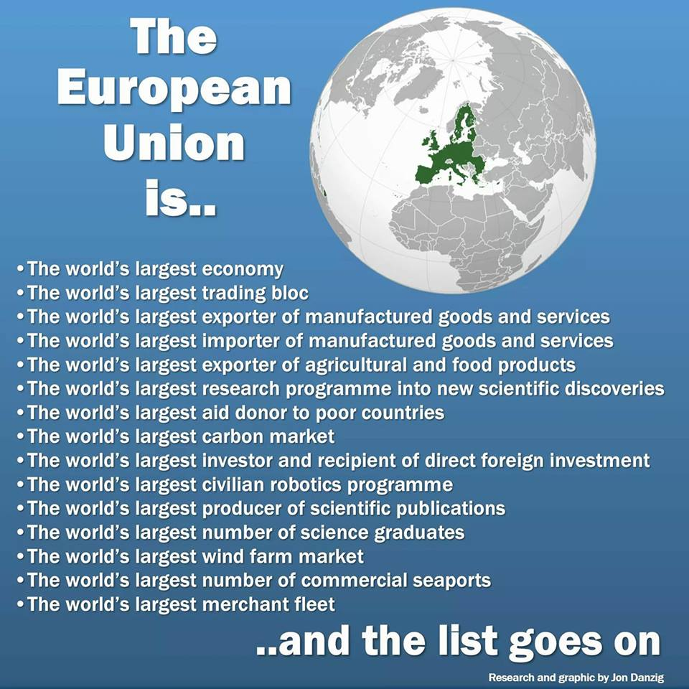
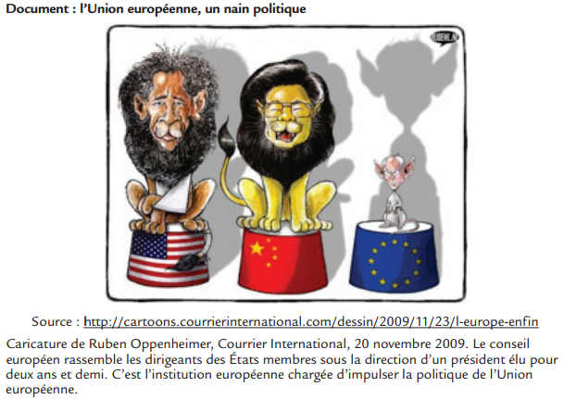
Can Europe be a political power ?
important potential
But a political dwarf

Slide 9
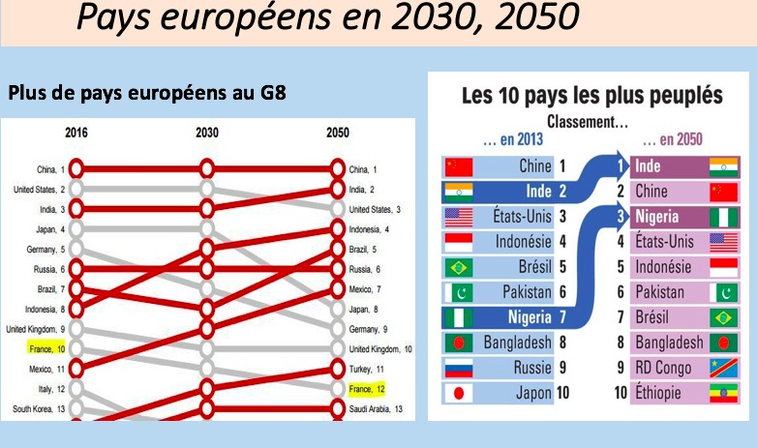
Without federation, no more individual european countries in international foras

Slide 10
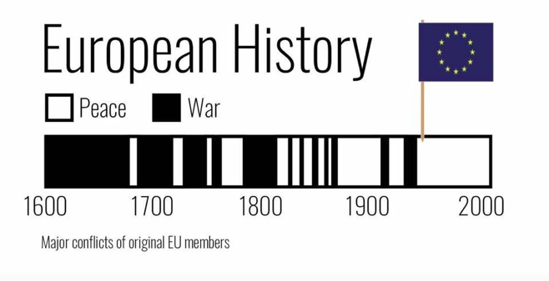
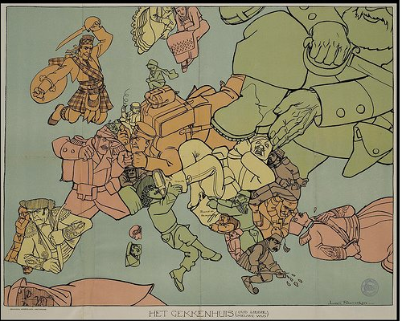
Challenge : peace to be consolidated.

Slide 11


Challenge : democracy, human rights
No european federalism without clear set of values

Slide 12
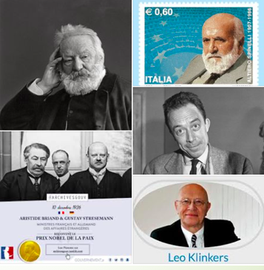
When, an european federation ?
-A dream since…Victor Hugo, 1857, many other dreamers since !
-how to transform a dream in reality ?
-Confidence building
-Clarity on concepts
-Explanations, education
-Citizens involvement and acceptation,
-Elections.
A federal constitution for Europe.

Slide 13
Federate the federalists !
A federal constitution :
structures, functionning, democracy, values…
Promote the urgent need of european federalism through european elections in 2019

